Slide 1

HOPE FOUNDATION’S
INTERNATIONAL INSTITUTE OF INFORMATION TECHNOLOGY , (I2IT)
http://www.isquareit.edu.in
+91 20 22933441 / 2

Slide 2

TESTING GMAIL AND AMAZON WEBSITE USING SELENIUM TOOL
GROUP ID: G8
1. Sejal Kalyankar (BC040)
2. Tejal Jadhav (BC064)
3.Shraddha Jagtap (BC072)
Guided by:
Prof. Kimi Ramteke

Slide 3
CONTENTS
Introduction
Selenium Framework
Automation tool-Selenium
Title Knowledge
How it works?
Motivation
Objectives
Advantages and Disadvantages
Software Requirements
Hardware Requirements
Learning Outcomes
Conclusion

Slide 4
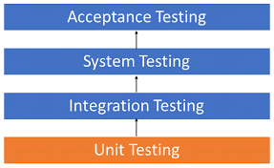
INTRODUCTION
Unit Testing is a type of testing which is done by software developers
The goal of unit testing is to break each part of source code and check that each part works properly.
Unit testing is done before integration testing
Unit Testing of software product is carried out during the development of an application

Slide 5
Execution of automation testing requires a comprehensive understanding of numerous automation tools and frameworks.
Among these tools, Selenium is the most popular due to its ease of use and relevant features.
Selenium WebDriver is a web framework that permits you to execute cross-browser tests. This tool is used for automating web-based application testing to verify that it performs expectedly. Selenium WebDriver allows you to choose a programming language to create test scripts.
Selenium is used to automate tests on websites to monitor their performance.
It is a browser automation framework that accepts commands and sends them to a browser. It is implemented through a browser-specific driver. It controls the browser by directly communicating with it.

Slide 6
SELENIUM FRAMEWORK
Components of the Hybrid Framework are similar to the components of the Keyword Driven Framework wherein every Test Data , as well as the Keywords, are externalized making the script appear in a more generalized form
Function Library
Excel Sheet to store Keywords
Design Test Case Template
Object Repository for Elements/Locators
Test Scripts or Driver Script
It Framework can be created and used to automate any application
frameworks can be created according to the project needs and used for automation purposes

Slide 7
Automation Tool-Selenium
Selenium:- Selenium is a suite of tools to automate web app testing across many platforms. Selenium runs in many browsers and operating systems. Can be controlled by many programming languages and testing frameworks.
Create by developers at Thought Works
Released publically as an Open Source project on OpenQA
Selenium is a test tool for web applications.
Selenium tests run directly in a browser.
Runs on Windows, Linux, and Macintosh.
Runs in Internet Explorer, Mozilla and Firefox.
Enables Browser Compatibility Testing.
Enables System Functional Testing.

Slide 8

TITLE KNOWLEDGE
The Selenium testing tool is used to automate tests across browsers for web applications. It's used to ensure high-quality web applications whether they are responsive, progressive, or regular. Selenium is an open-source tool.
Selenium consists of a number of tools: Selenium IDE, Selenium WebDriver and Selenium Grid. These tools support a number of browsers, operating systems, and programming languages, so that Selenium essentially fits the needs of many software testers.

Slide 9
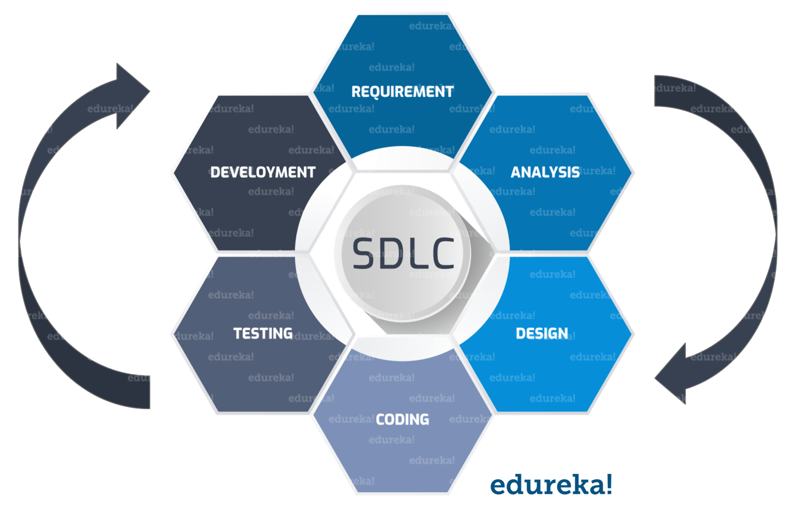
Software Development Life Cycle (SDLC) :

Slide 10
MOTIVATION
As it supports Multiple Programming Languages and Because Selenium is quite robust when it comes to language support and can efficiently support every tester's language bindings.

Slide 11

OBJECTIVES
Develop test cases to detect bugs and errors.
Automation framework design and implementation according to project structure.
Improve and automate test practices.
Participate in communicating best practices.
Speed up common tasks to lift productivity get a lot more done with existing resources.
Reduce mistakes or errors which ideally improve quality of output too.
Improve safety for humans

Slide 12
ADVANTAGES AND DISADVANTAGES
Advantages
Disadvantages
Open-Source
Supports Operating Systems
Support across browsers.
Tests across devices.
Constant updates.
Ease of implementation.
Reusability and Add-ons.
Low cost maintainance
No reliable Technical Support from anybody. ...
It supports Web-based applications only. ...
Difficult to use, takes more time to create Test cases. ...
Difficult to Setup Test Environment when it compares to Vendor Tools like UFT, RFT, SilkTest.
Limited support for Image Testing.

Slide 13
Software Requirements
Eclipse
Java
selenium.jar file
Cromedriver.exe
Hardware Requirements
PIV (Personal Identification Verification)
2GB RAM
500 GB HDD (Hard Disk Drive)

Slide 14
Learning Outcomes:
Hybrid Framework in Selenium is a concept where we are using the advantage of both Keyword driven framework as well as Data driven framework.
It is an easy to use framework which allows manual testers to create test cases by just looking at the keywords, test data and object repository without coding in the framework.
Improved test efficiency.
Allows manual testers , to create test cases by just looking at the keywords , test data without code in framework.
Maximum test coverage.
Open Source Availability.
Multi-Browser Support, Support Across Various Operating Systems.
Ease Of Implementation.
Reusability and Integrations.
Flexibility.
Parallel Test Execution and Faster Go-to-Market.

Slide 15
CONCLUSION
Software testing is an important part of the software development process. It is not a single activity that takes place after code implementation, but is part of each stage of the lifecycle.
A successful test strategy will begin with consideration during requirements specification. Testing details will be fleshed through high and low level system designs, and testing will be carried out by developers and separate test groups after code implementation.
As with the other activities in the software lifecycle, testing has its own unique challenges. As software systems become more and more complex, the importance of effective, well planned testing efforts will only increase.

Slide 16
Thank You!

